Slide 1
CATEGORICAL DATA ENCODING FOR REGRESSION MODELS

Slide 2






Hello, I am Hristo!
SPO & Power Platform Engineer
analytics and ML passionate
museum geek
in/hthristov
@HristoChr
/hristochr

Slide 3
AGENDA
Justification
Terminology
Encoding methods & demo
Comparison
Future work

Slide 4
JUSTIFICATION
1
Why this topic?

Slide 5
TABULAR DATA 3x4
 | Feature 1 | Feature 2 | Feature 3 | Feature 4
Row 1 | 1 | abc | jkl | Stu
Row 2 | 2 | def | mno | Vwx
Row 3 | 3 | ghi | pqr | yz
Notes:
Explain tabular data
Difference between numeric and categorical features
mention bool
the concept of dimensionality 3x4

Slide 6
CHALLENGE
Feed the tabular data into the regression model
Text data must be represented numerically
Simple forms of representation tend to produce poor predictions
The representation must be numerically consistent among the various features and feature values
Notes:
The challenge is to convert our data or
Statistically represent the categorical features in a way that is comprehensible for the ANN

Slide 7
CHALLENGE
Cardinality?
How to tune my neural network regarding the encoding method?
Feature-agnostic results
Tuning is a continuous process

Slide 8
TERMINOLOGY
2
Some groundwork

Slide 9
LIST OF TERMS
Prediction
Cardinality
Number of layers
Number of neurons in each layer
Hyperparameter (tuning)
Activation function
Loss
Notes:
non-exhaustive list of basic ANN terminology
Important for this context
so we can explore the methods

Slide 10
PREDICTION
A practical application of neural networks often involves regression
Predicting quantitative target values explored here is called "regression"
Regression is a type of supervised learning
Notes:
In principle, neural networks can compute any computable function, i.e., they can do everything a normal digital computer can
Practical applications of neural networks often involve supervised learning.
Unsupervised learning is when we have no labelled data
After a successful training episode, you can present input data alone to the neural network (that is, input data without the desired result), and it will compute an output value that approximates the target.
This type of supervised learning with quantitative target values explored here is called "regression."

Slide 11
CARDINALITY
[…] the cardinality of a set is a measure of the number of elements of the set […]

Slide 12
TYPES OF LAYERS
Every neural network has three types of layers:
Input
Hidden
Output
Typically two hidden layers can approximate the target value with relatively acceptable loss
Notes:
Layer types
Config of layers
Tensorflow quick glance

Slide 13
TYPES OF LAYERS
quick demo with TF Playground
Notes:
Layer types
Config of layers
Tensorflow quick glance

Slide 14
NUMBER OF NEURONS
Input layer = feature count
Hidden layer(s) = hyperparameter
Output = 1 (regression)
Notes:
No hard rule for the number of neurons in each layer
input: input data dimensionality
Hidden: here we use 40 – 20
Output: depends on the model, here it is a regression => 1

Slide 15
HYPERPARAMETERS
varying upper and lower bounds
positive or negative
integer or floating-point numbers
categorical
Notes:
Possible types of hyperparameters
varying upper and lower bounds, e.g. layer count and neuron count;
positive or negative;
integer or floating-point numbers, e.g. epoch count and regularizer values;
categorical, such as the name of the optimizer function.
+ Our categorical encoding methods have, for example:
Smooth mean weigh – int
Hashing function – method
Embedding size - int

Slide 16
ACTIVATION FUNCTION
ReLU
(𝑧)=𝑚𝑎𝑥(0,𝑧)
Linear
𝑔(𝑧) = 𝑔(𝑧)
Notes:
The activation function is of critical importance
Otherwise it is just linear transformation
The units (neurons) in neural networks transform their net input by using a scalar-to-scalar function referred to as an "activation function". For our model two activation functions are used:
RELU: This function is linear for inputs less than 0. This property makes it ideal for gradient-based optimization models
LINEAR: If a unit does not transform its net input, it is said to have an "identity" or "linear" activation function.

Slide 17
LOSS
Error functions is what we refer to as “loss”
Sum of the case-wise error functions for all the cases in a data set
Regression models rely heavily on the RMSE metric to gauge their performance.
Notes:
Definition of loss
Our method of measuring network performance
Data -> encode categorical data -> feed data into model -> evaluate -> Score (loss)
RMSE: root-mean-square error

Slide 18
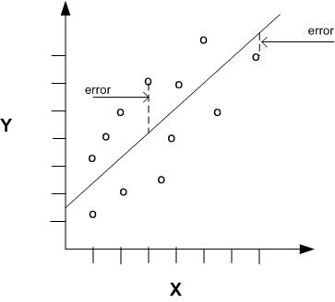
LOSS
The difference between actual and predicted values

Slide 19
ENCODING METHODS
3
A curated selection

Slide 20
One-hot encoder
For each unique value in each feature, we get a new feature that will contain either a 0 or a 1 for the corresponding case.
Notes:
Define one-hot encoder and jump to demo

Slide 21
ONE-HOT ENCODER
 | Caller ID
Case 1 | Caller ID 1
Case 2 | Caller ID 2
Case 3 | Caller ID 3
 | Caller ID 1 | Caller ID 2 | Caller ID 3
Case 1 | 1 | 0 | 0
Case 2 | 0 | 1 | 0
Case 3 | 0 | 0 | 1

Slide 22
Target encoder
Calculate, for each feature value, an average of the corresponding values in the target variable 𝑦. Then replace each unique feature value with the according mean.
Notes:
- Define target encoder

Slide 23

TARGET ENCODING PROCESS
The mean for the target value
is calculated
The count and mean of the target value are calculated
The smoothed mean is calculated
The mean for the target value is calculated over the whole dataset
For each unique feature value, i.e. a grouping is performed per the cardinality
$$μ=\frac{n ×x + m × w }{n+m}$$
Notes:
Encoding explanation
Emphasize grouping by unique feature value

Slide 24

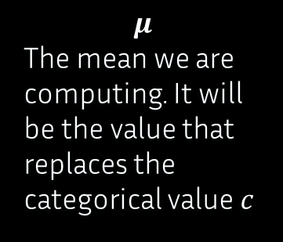
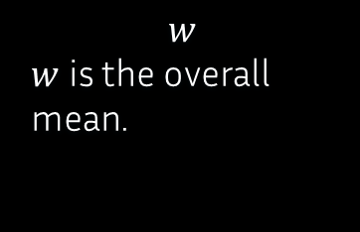
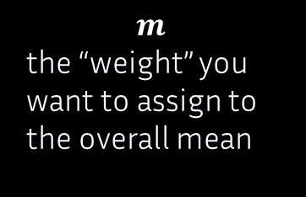
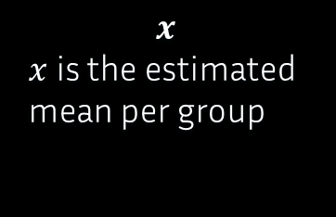
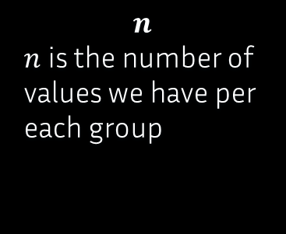
FORMULA BREAKDOWN
$$μ=\frac{n ×x + m × w }{n+m}$$
$$μ$$
The mean we are computing. It will be the value that replaces the categorical value $c$
$$n$$
$n$ is the number of values we have per each group
$$x$$
$x$ is the estimated mean per group
$$m$$
the “weight” you want to assign to the overall mean
$$w$$
$w$ is the overall mean.
Notes:
Formula breakdown
jump to code demo

Slide 25
Binary Encoder
Convert each categorical feature vector into its binary representation after substituting each value with its ordinal representation.
Notes:
Define the binary encoder

Slide 26

BINARY ENCODING PROCESS
Assign ordinal numbers to the
values in the vector
Convert those numbers to their binary representations
Extract the new feature vectors
category
category 1
category 2
category 3
category
1
2
3
$$\text{category}$$
$$\text{01 }$$
$$\text{10 }$$
$$\text{11 }$$
category_0 category_1
0 1
1 0
1 1
Notes:
Explain the process

Slide 27
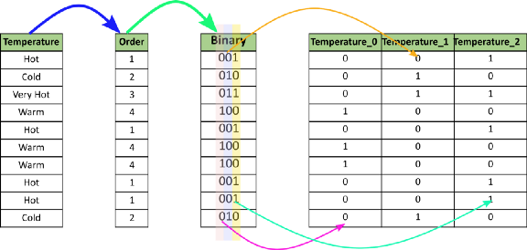
BINARY ENCODER
source
Notes:
Explain again
Mention the moderate increase in dimensionality
As compared to one-hot

Slide 28
Hashing Encoder
Using a hash function to map feature values to indices in the resulting feature vector. After hashing, we get the location in the vector we have defined by the vector size hyperparameter function.
Notes:
Define hashing encoder

Slide 29
HASHING ENCODING PROCESS
Take input feature value
Hash the value
Extract the new feature vectors
Assign ordinal numbers to the values in the vector
“Category 55”
Sha256(“Category 55”) =
bebba9921075d9a9893029024fb663506ec7ad9a743659ac6fd3fde8e58c6fd7
Convert from the hexadecimal to the integer representation
int(hasher.hexdigest(), 16)
int(hasher.hexdigest(), 16) % 15
Notes:
Process walkthrough

Slide 30
HASHING ENCODER
 | String | Hashed result | Int | Resulting index (%15)
Case 1 | Category 9 | 8fb39ab2e53213eeb63d7c75b33cfe7c030d70a794e86f214ccc0ce4fbd75724 | 64998070663947452461325594555334598255818671955394119968827074088872107792164 | 4
Case 2 | Category 20 | 9e0d81fcaba150a5e640ced7f14155d2ba1f281c0d5f7596c268638af6aad86b | 71489296225258267494126183005618808030794362809869266305654010254208759683179 | 14
Case 3 | Category 40 | f324c56964d5ac196dd7fc48a308d79bf1c829ee95bde4c5db3ac460f02d3bea | 109976991185509600839963661068367643614311817999712487004505233179993518717930 | 5
Notes:
demo

Slide 31
Entity Embeddings
Requires a different network topology based on the feature cardinality. One input and one embedding layer are needed for each encodable value.
Notes:
Define entity embeddings
Mention NLP and word representation in NLP models

Slide 32

ENTITY EMBEDDING PROCESS
Establish an embedding size for
each categorical feature
Cardinality is input dimension, embedding size is the output dimension.
Each feature is converted into a list of 1 x 85024 values.
int(min(np.ceil((no_of_unique_values_in_feature)/2), 50))
We want to map the larger input space to the more compact output space.
$$\text{Each} \text{value} \text{is} \text{the} \text{index} \text{of} \text{the} \text{unique} \text{values}\text{. }$$
Notes:
Process walkthrough
85024 because of the train/val/test split

Slide 33
ENTITY EMBEDDING PROCESS
A multidimensional array is instantiated.
This multidimensional array is passed to model
Its elements are lists containing the encoded categorical values.
From this input, the input layers are extracted and after them the embedding layers. The matrices of the embedding layers are concatenated. The result is a dense layer with an input of size the sum of all embedding sizes.

Slide 34
IMPACT FEATURE EXAMPLE
Raw string value | Embedding vector
1-High | [v1, v2]
2-Medium | [v1, v2]
3-Low | [v1, v2]
Notes:
Further explanation with the impact feature

Slide 35
COMPARISON
4

Slide 36
COMPARATIVE TABLE
 | Starting dimensionality | Resulting dimensionality | Performance over 20 epochs, batch size 512 (loss)
One-hot | 20 | 8 010 | -
Target | 20 | 20 | 0.5158
Binary | 20 | 121 | 0.8355
Hashing | 20 | 20 | 0.8726
Entity embeddings | 20 | [ 1 5 x emb. size ] | 1.0927
Notes:
Final comparative analysis
Ordered by loss, ascending
Best is target
BUT for this dataset!
Therefore categorical encoding is
Dataset-agnostic
One encoder will never produce identical results over two diff datasets

Slide 37
Notes:
WINNER: Target encoder
Mention what is a good and what is a bad loss
No firm range, depends on data
If we are sure of the model and the encoding, we can say the problem is highly nonlinear
Hence relatively higher but acceptable loss (0.5)
Mention other methods

Slide 38
FUTURE WORK
4
More encoding!

Slide 39
EXPERIMENT YOURSELF
ml.azure.com (Azure Machine Learning)
Create a workspace
Attach a compute resource
Import data & notebook(s)
studio.azureml.net (Azure ML Studio)
Built-in hashing encoder
Run custom python code

Slide 40
WANT MORE?
Coding Systems For Categorical Variables In Regression Analysis
All about Categorical Variable Encoding
Link to notebook
Notes:
Two sources I recommend
That helped a lot
Entity embeddings is a bit different ☺

Slide 41
THANKS!
ANY QUESTIONS?
Reach out to me:
in/hthristov
@HristoChr
/hristochr

